Slide 1

PRESENTATION
EXCELR
BANK ANALYTICS
3 OCTOBER, 2025

Slide 2
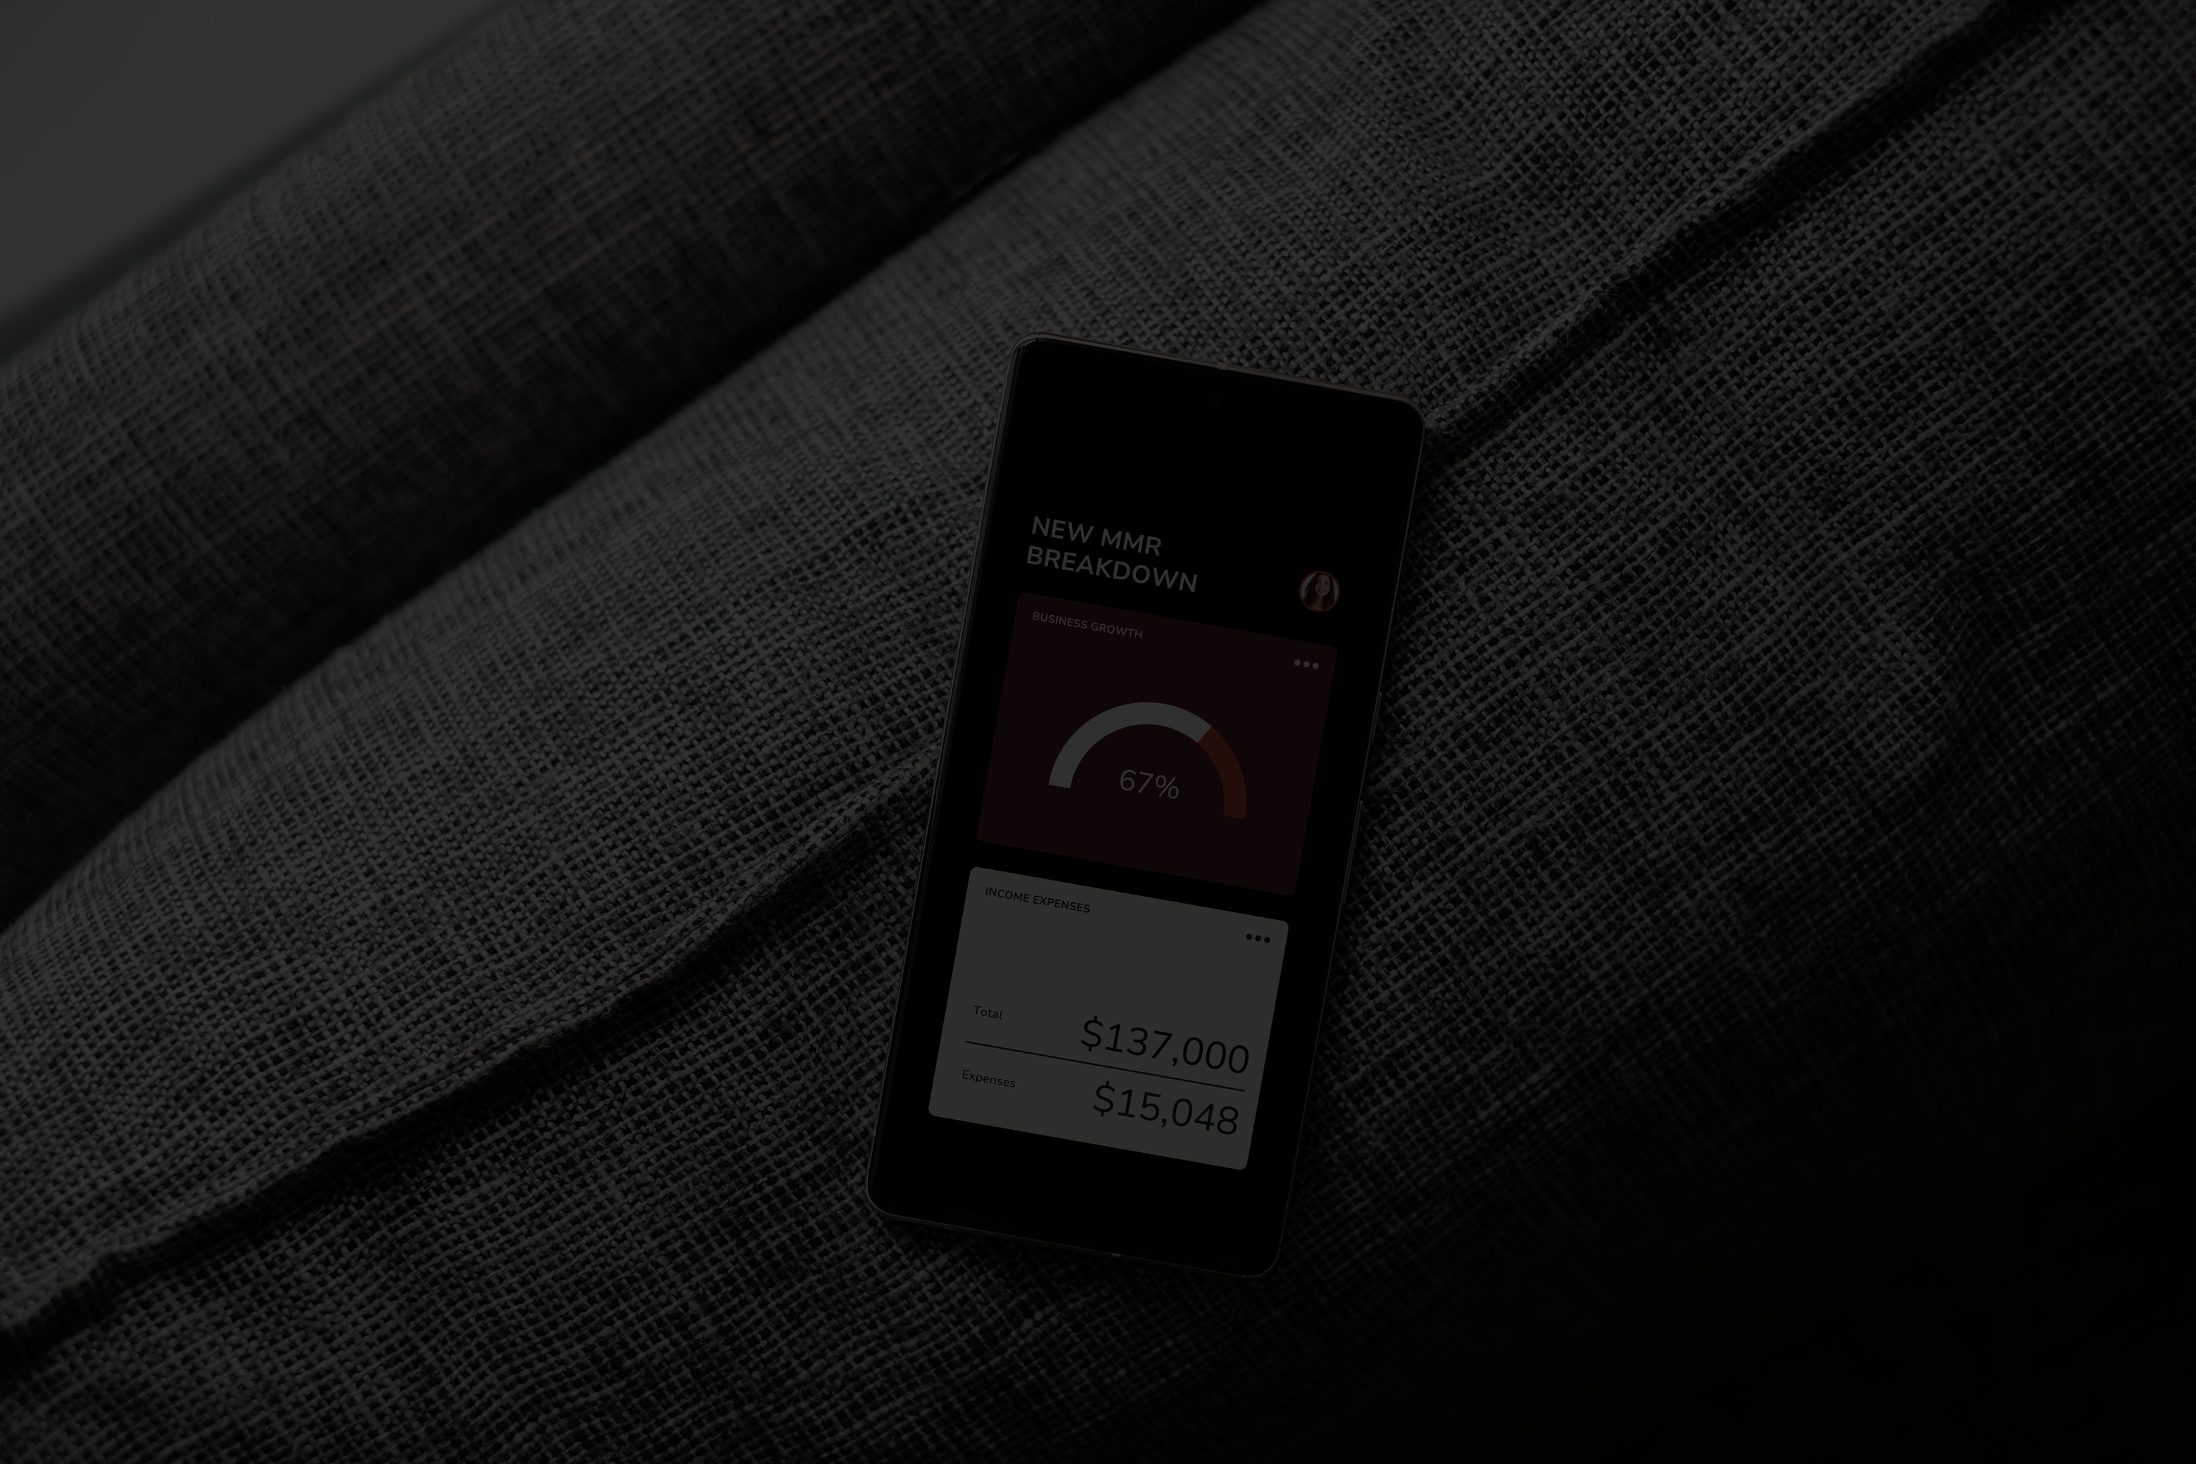
PROJECT CONTRIBUTORS
RANGAREDDYGARI BHARATHSIMHAREDDY
LAKSHMI LIKITHA
SHAIK INAYATHULLA
KAVALI ANUSHA
KIRAN SHINDE
SAYALI SANKET MANE

Slide 3
PROJECT SUMMARY
Bank AnalyTICS IS A DATA-DRIVEN PROJECT AIMED AT MONITORING AND ANALYZING FINANCIAL TRANSACTIONS ACROSS BANK BRANCHES AND CUSTOMER SEGMENTS. IT TRACKS DEBIT AND CREDIT ACTIVITY, VISUALIZES TRANSACTION TRENDS OVER TIME, AND BREAKS DOWN PAYMENT METHODS LIKE DEBIT CARDS, CREDIT CARDS, AND NET BANKING. THE DASHBOARD HIGHLIGHTS TOP-PERFORMING BRANCHES AND IDENTIFIES HIGH-VALUE CUSTOMERS BASED ON TRANSACTION AMOUNTS AND ACCOUNT BALANCES, OFFERING A CLEAR VIEW OF OPERATIONAL PERFORMANCE AND CUSTOMER BEHAVIOR.
BUILT USING TOOLS LIKE EXCEL, POWER BI, TABLEAU, SQL, AND POWER QUERY, THE PROJECT INVOLVED COLLABORATIVE TEAMWORK, WEEKLY PROGRESS REVIEWS, AND FINAL PRESENTATIONS . THE INSIGHTS GENERATED HELP BANKS OPTIMIZE RESOURCE ALLOCATION, ENHANCE CUSTOMER ENGAGEMENT, AND MAKE INFORMED STRATEGIC DECISIONS.

Slide 4
BANK DASHBOARD KPI LIST
TOTAL LOan Amount Funded: MeaSURES THE TOTAL VALUE OF LOANS DISBURSED.
TOTAL LOANS: TRACKS THE NUMBER OF LOANS ISSUED.
TOTAL COLLECTION: REFLECTS REPAYMENT PERFORMANCE, INCLUDING PRINCIPAL AND INTEREST.
TOTAL INTEREST: CAPTURES REVENUE FROM INTEREST FEES.
BRANCH-WISE PERFORMANCE: ANALYZES REVENUE (INTEREST, FEES, TOTAL) BY BRANCH.
STATE-WISE LOAN: SHOWS GEOGRAPHIC DISTRIBUTION OF LOANS.
RELIGION-WISE LOAN: MONITORS LOAN DISTRIBUTION ACROSS RELIGIOUS DEMOGRAPHICS.
PRODUCT TYPE LOAN-WISE: CATEGORIZES LOANS BY PRODUCT TYPES (E.G., PERSONAL, AUTO).
DISBURSEMENT TREND: TRACKS CHANGES IN LOAN DISBURSEMENTS OVER TIME.
GRADE-WISE LOAN: ASSESSES PORTFOLIO RISK BY BORROWER CREDIT GRADES.
DEFAULT LOAN COUNT: COUNTS LOANS IN DEFAULT.
DELINQUENT CLIENT COUNT: TRACKS BORROWERS WITH MISSED PAYMENTS.
DELINQUENT LOAN RATE: PERCENTAGE OF LOANS OVERDUE IN THE PORTFOLIO.
DEFAULT LOAN RATE: PROPORTION OF DEFAULTED LOANS TO THE TOTAL PORTFOLIO.
LOAN STATUS-WISE LOAN: BREAKS DOWN LOANS BY STATUS (ACTIVE, DELINQUENT, CLOSED).
AGE GROUP-WISE LOAN: CATEGORIZES LOANS BY BORROWERS’ AGE GROUPS.
LOAN MATURITY: TRACKS THE TIMELINE UNTIL FULL REPAYMENT.
NO VERIFIED LOANS: IDENTIFIES LOANS WITHOUT PROPER VERIFICATION.

Slide 5

DEBIT AND CREDIT DASHBOARD KPI LIST
TOTAL CREDIT Amount : MeaSURES THE TOTAL AMOUNT OF DEPOSITS OR CREDITS, WHICH CAN BE COMPARED AGAINST TOTAL WITHDRAWALS.
TOTAL DEBIT AMOUNT : MEASURES THE TOTAL AMOUNT OF WITHDRAWALS OR DEBIT.
CREDIT TO DEBIT RATIO : SHOWS THE RATIO OF CREDITS TO DEBITS, HELPING TO UNDERSTAND WHETHER THE BANK IS RECEIVING MORE DEPOSITS THAN WITHDRAWAL.
NET TRANSACTION AMOUNT : MEASURES THE NET CASH FLOW (POSITIVE OR NEGATIVE) FOR THE BANK OVER A PERIOD.
ACCOUNT ACTIVITY RATE : INDICATES HOW ACTIVE A CUSTOMER IS IN RELATION TO THEIR ACCOUNT BALANCE.
TRANSACTIONS PER DAY/WEEK/MONTH : IDENTIFIES TRANSACTION VOLUME TRENDS OVER TIME, HELPING TO DETECT PERIODS OF HIGH OR LOW ACTIVITY.
TOTAL TRANSACTION AMOUNT BY BRANCH : MEASURES THE TOTAL TRANSACTION VOLUME PER BRANCH, HELPING TO COMPARE BRANCH PERFORMANCE

Slide 6

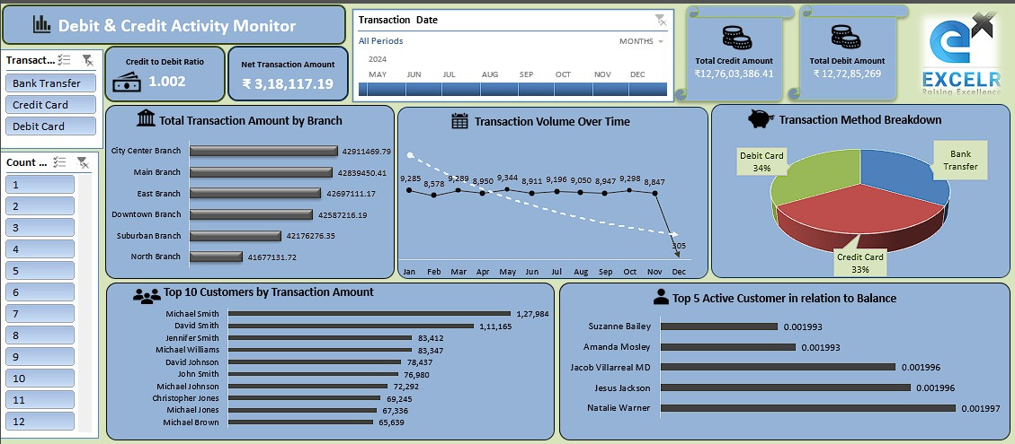
EXCEL DASHBOAD

Slide 7

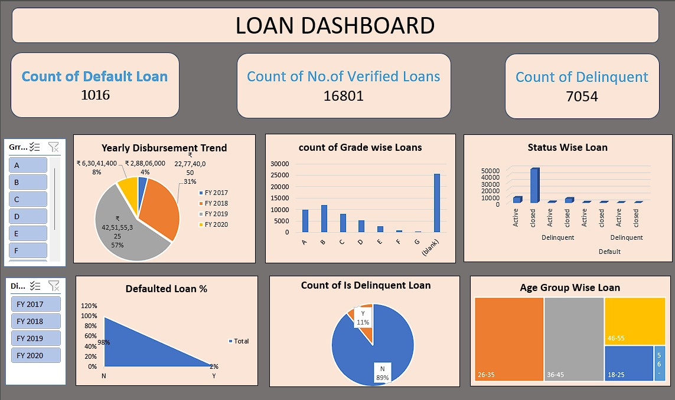

Slide 8
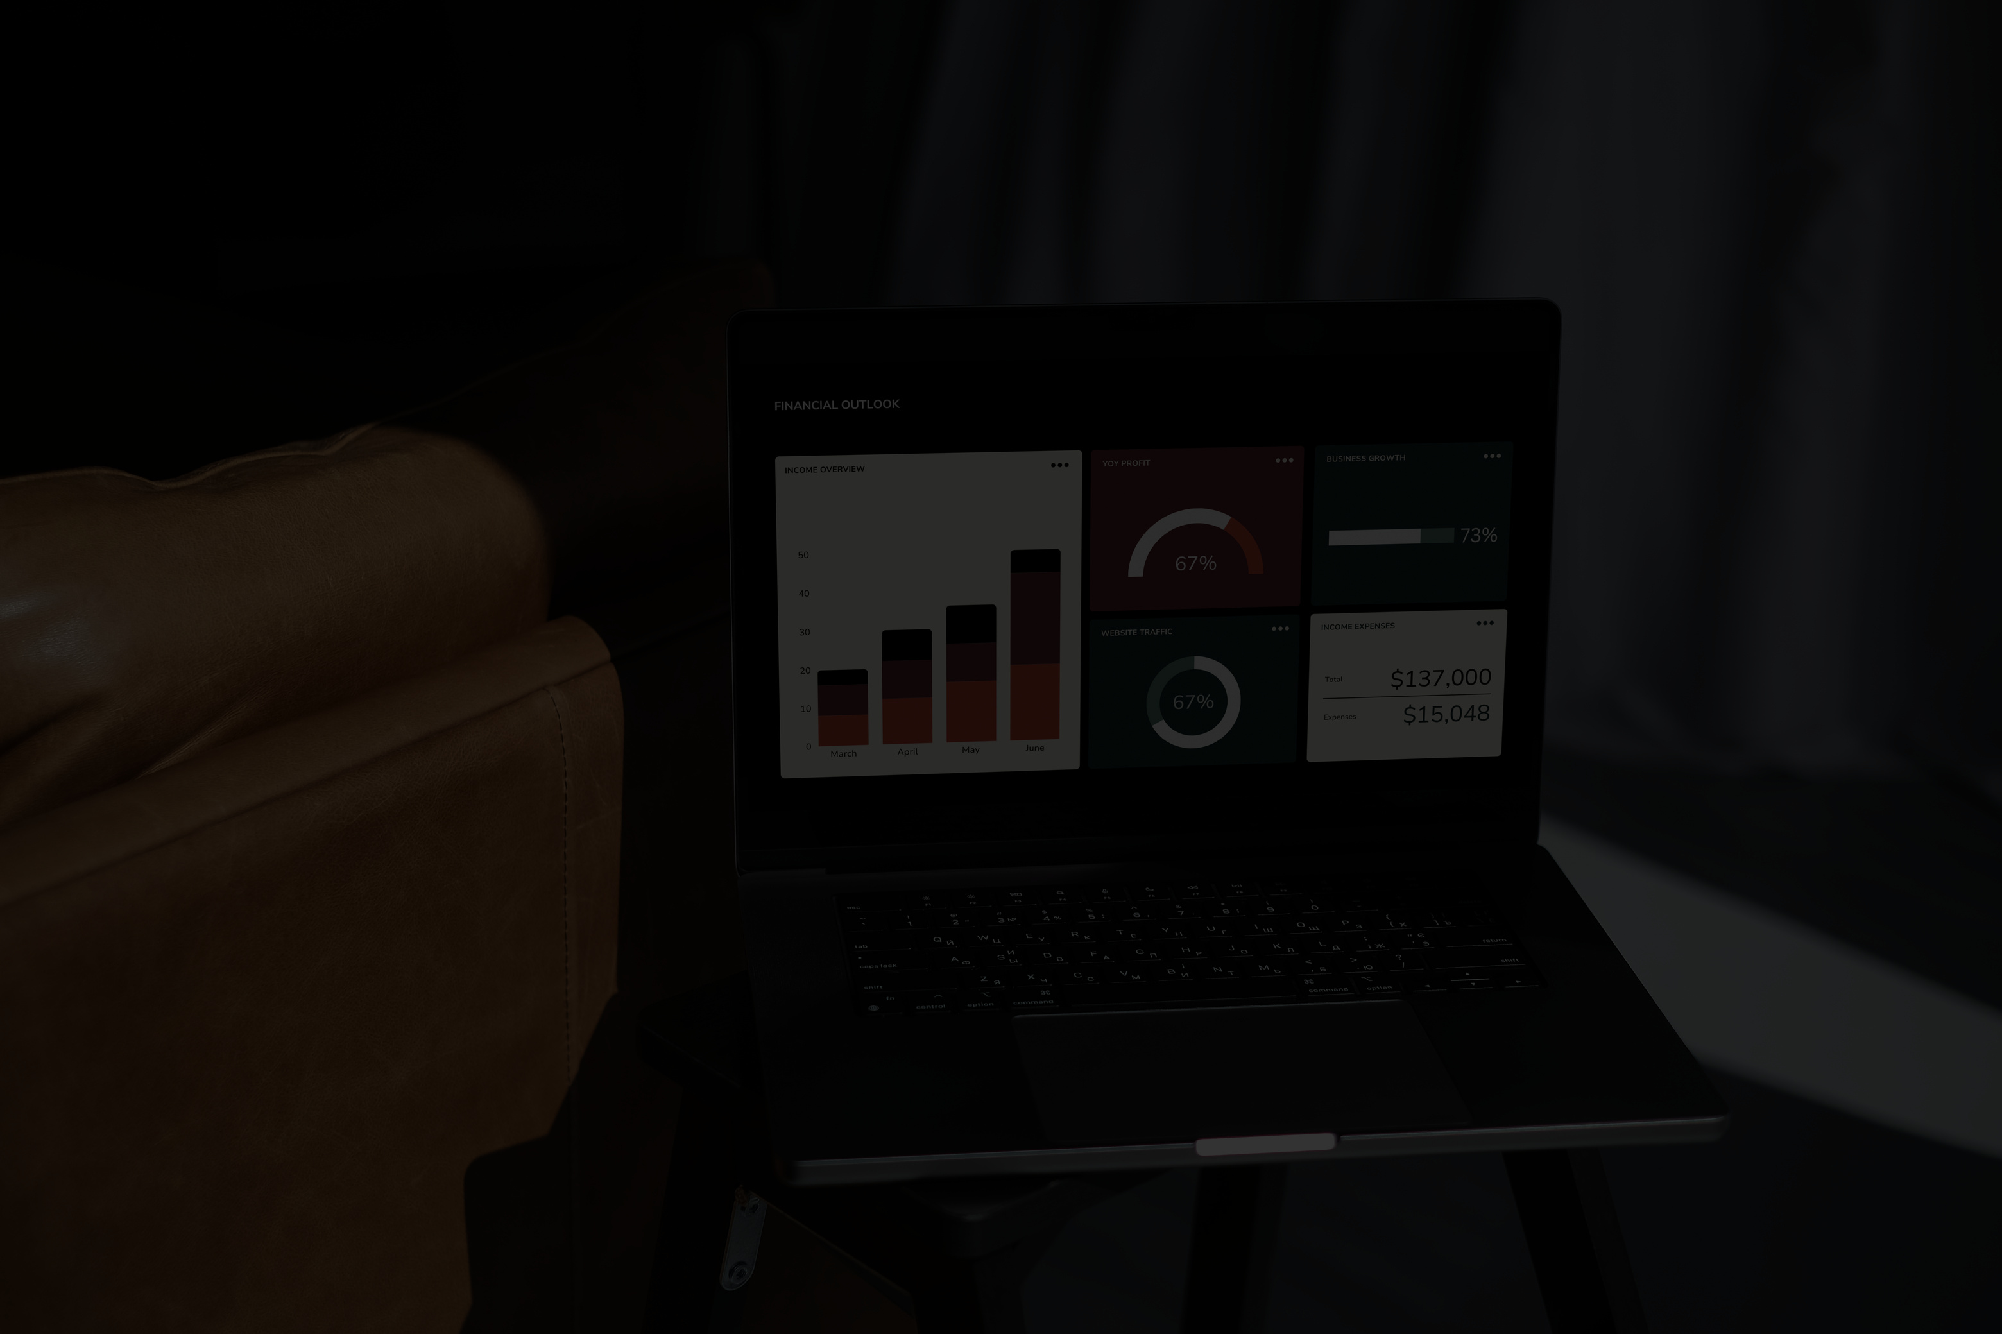
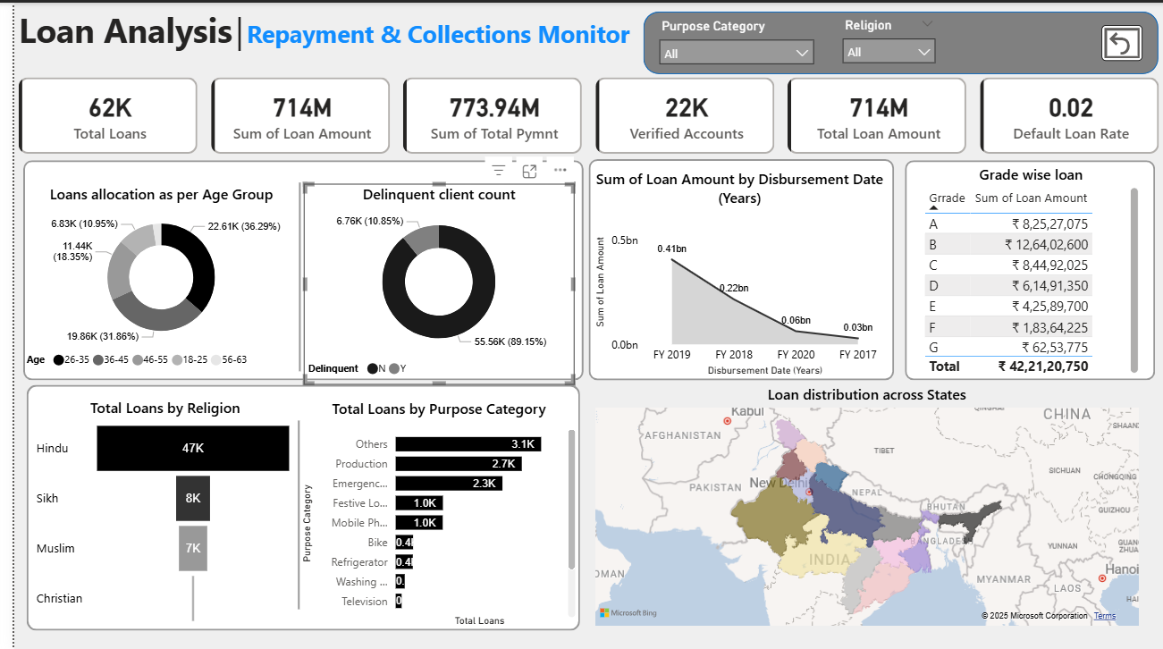
POWER BI DASHBOARD

Slide 9
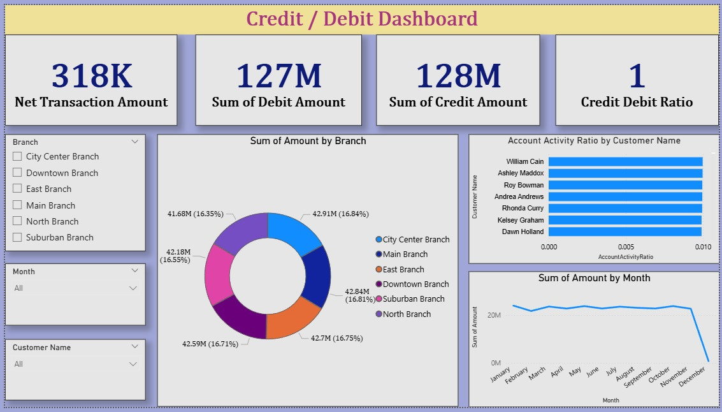

Slide 10
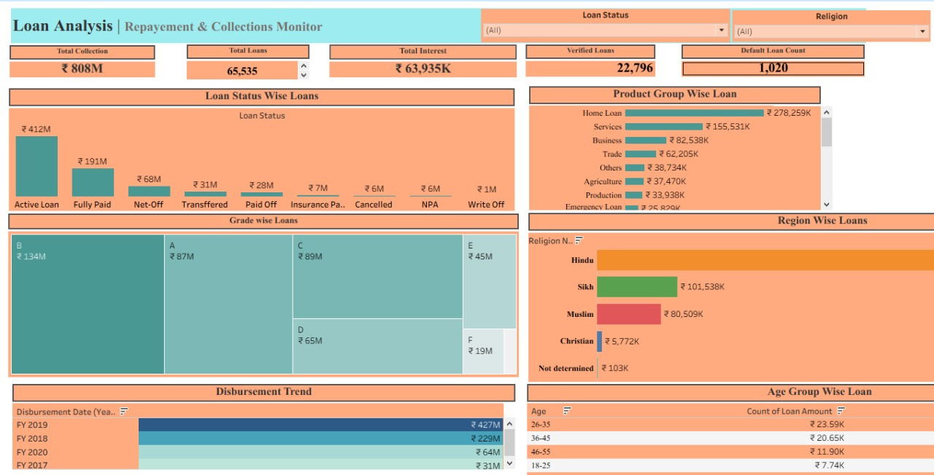
TABLEAU DASHOARD

Slide 11
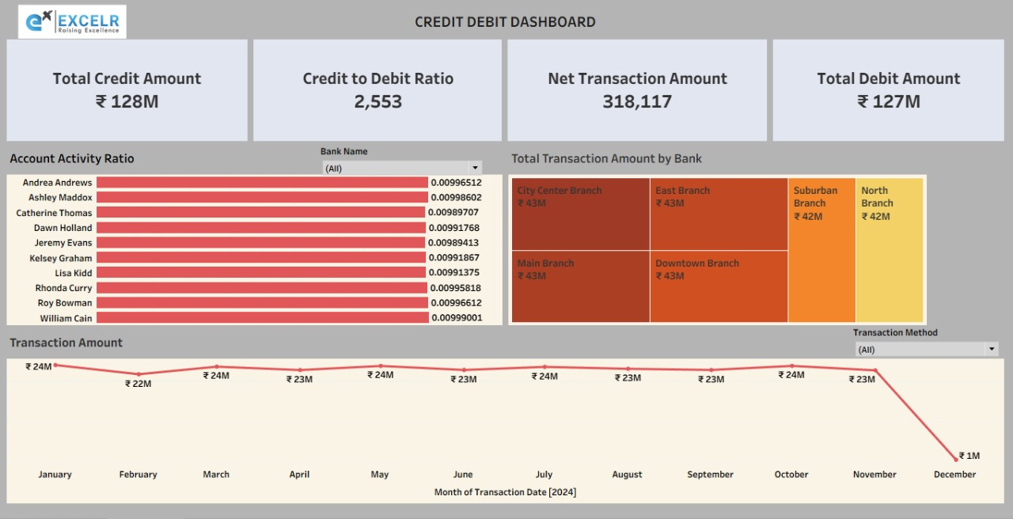

Slide 12
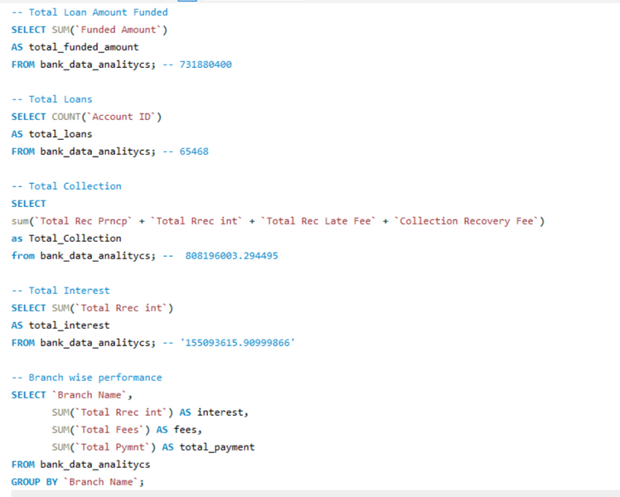
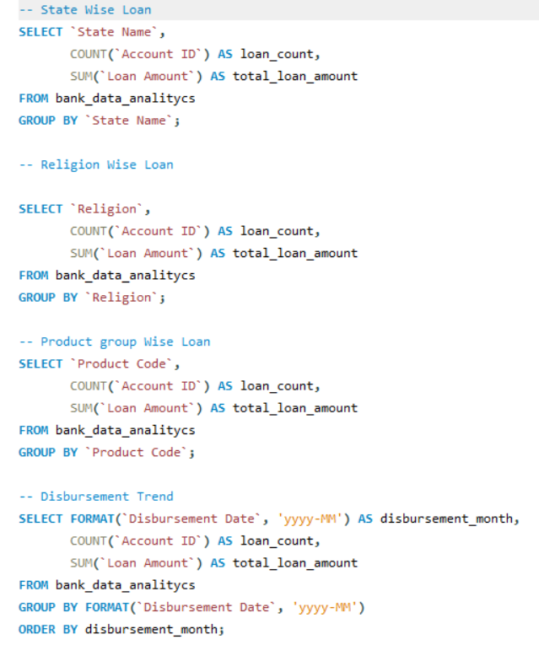
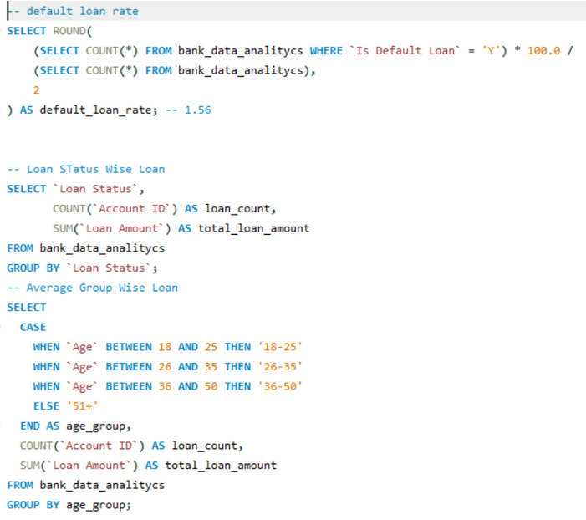
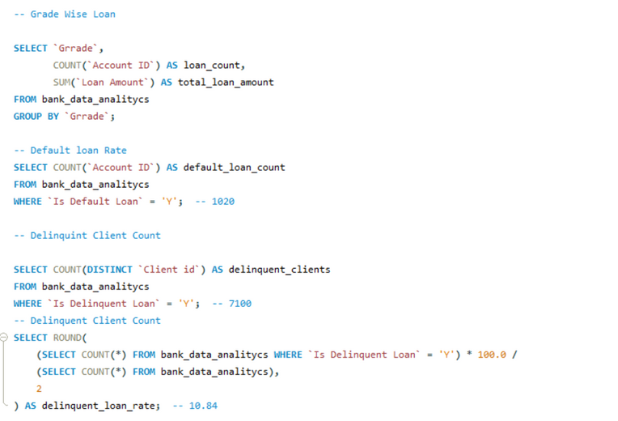
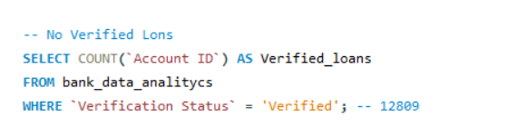
SQL QUERIES
FOR
LOAN ANALYTICS

Slide 13
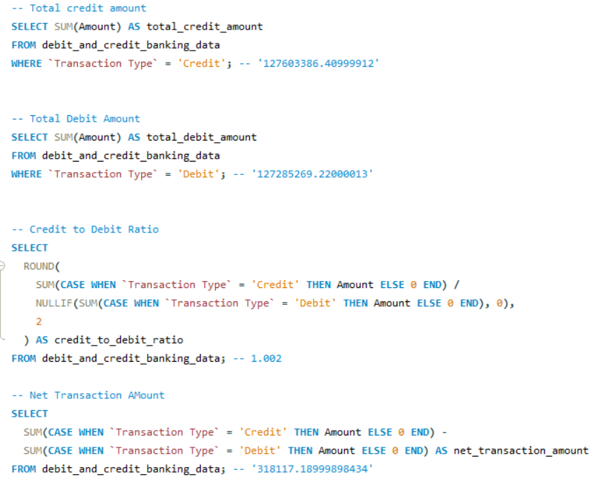
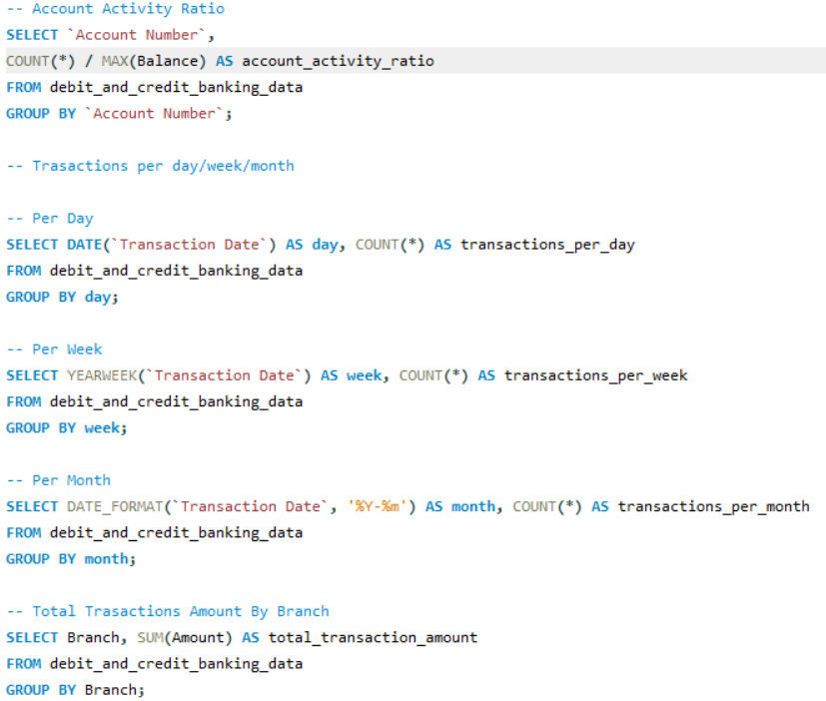
SQL QUERIES
FOR
CREDIT & DEBIT ANALYTICS

Slide 14
KEY INSIGHTS FOR LOAN DASHBOARD
STROng Repayment PeRFORMANCE: TOTAL COLLECTION (₹43M) EXCEEDS THE TOTAL LOAN AMOUNT FUNDED (₹43M), INDICATING EFFECTIVE REPAYMENT.
LOW DEFAULT RISK: DEFAULT LOAN RATE IS JUST 0.03, SHOWING MINIMAL RISK IN THE PORTFOLIO.
AGE GROUP DISTRIBUTION: MAJORITY OF LOANS ARE HELD BY BORROWERS AGED 31–45 (45%), FOLLOWED BY 18–30 (25%), SUGGESTING A YOUNG-TO-MID CAREER BORROWER BASE.
DELINQUENCY OVERVIEW: ONLY 0.3K CLIENTS ARE DELINQUENT OUT OF 3K, REINFORCING STRONG REPAYMENT BEHAVIOR.
LOAN GROWTH TREND: DISBURSEMENTS HAVE STEADILY INCREASED FROM FY 2018 TO FY 2021, SIGNALING PORTFOLIO EXPANSION.
CREDIT GRADE SPREAD: HIGHER LOAN AMOUNTS ARE ASSOCIATED WITH LOWER CREDIT GRADES (GRADE G: ₹10.3M), INDICATING RISKIER LENDING.
DEMOGRAPHIC & PURPOSE INSIGHTS: LOANS ARE DIVERSIFIED ACROSS RELIGIONS AND PURPOSE CATEGORIES, WITH NOTABLE ALLOCATIONS TO PRODUCTION AND EDUCATION.
GEOGRAPHIC REACH: LOANS ARE WIDELY DISTRIBUTED ACROSS INDIAN STATES, WITH INTENSITY VARYING BY REGION.

Slide 15
KEY INSIGHTS FOR CREDIT & DEBIT DASHBOARD
BalANCED TRANSACTIONS: CREDIT (₹128M) AND DEBIT (₹127M) AMOUNTS ARE NEARLY EQUAL, RESULTING IN A CREDIT-DEBIT RATIO OF 1.
POSITIVE NET FLOW: NET TRANSACTION AMOUNT STANDS AT ₹318K, INDICATING A SLIGHT SURPLUS IN DEPOSITS.
BRANCH PERFORMANCE: MAIN BRANCH LEADS WITH 42.38% OF TOTAL TRANSACTION VOLUME, FOLLOWED BY NORTH BRANCH (20.72%).
CUSTOMER ACTIVITY: CUSTOMERS LIKE WILLIAM CASH AND ASHLEY MADDOX SHOW HIGH ACCOUNT ACTIVITY RATIOS, SUGGESTING FREQUENT ENGAGEMENT.
MONTHLY STABILITY: TRANSACTION AMOUNTS REMAIN CONSISTENT ACROSS MONTHS, HOVERING AROUND ₹20M, INDICATING STABLE BANKING BEHAVIOR.

Slide 16

WE WANT TO SAY
THANK YOU
FOR YOUR ATTENTION

